Slide 1


FIRE AND SMOKE DETECTION IN CCTV FOOTAGE
Priya S
613521104030
Third Year CSE

Slide 2
TABLE OF CONTENT
Problem Statement
Proposed System/Solution
System Development Approach
Algorithm & Deployment
Result
Conclusion
Future Scope
References

Slide 3
PROBLEM STATEMENT
Fire and smoke detection in CCTV footage is a critical task for ensuring the safety and security of various environments, including residential, commercial, and industrial spaces.
Traditional methods rely heavily on manual monitoring, which is both labor-intensive and prone to human error. Automating the detection process using computer vision and Deep learning techniques presents an opportunity to enhance efficiency and accuracy in identifying potential fire and smoke incidents.

Slide 4
PROPOSED SYSTEM
Introduction
Purpose: Enhance safety and security through automated fire and smoke detection in CCTV footage.
Context: With the increasing prevalence of CCTV surveillance, leveraging this technology for early fire detection is crucial.
System Overview
Utilizes advanced computer vision algorithms to analyze CCTV footage in real-time.
Detects anomalies associated with fire and smoke by analyzing pixel variations, color changes, and motion patterns.

Slide 5
PROPOSED SYSTEM
Key Components
Preprocessing Module:
Cleanses footage to enhance clarity and reduce noise.
Normalizes lighting conditions for consistent analysis.
Feature Extraction:
Utilizes deep learning techniques to extract relevant features from video frames.
Focuses on pixel intensity, texture, and spatial relationships.
Classification Model:
Trained neural network for fire and smoke detection.
Incorporates convolutional layers for spatial feature extraction.
Employs recurrent layers for temporal analysis across frames.

Slide 6
SYSTEM APPROACH
Hardware Requirements
CPU:
A multi-core CPU is sufficient for running the training code. However, training dataset can be computationally intensive.so faster CPU may reduce training time.
Memory(RAM):
At least 4GB of RAM is recommended for handling large datasets
Higher RAM capacity may be beneficial for larger batch sizes to run efficiently.
Internet Connection:
An internet connection is needed to access resources dataset and documentation during development.

Slide 7
SYSTEM APPROACH
Software Requirements
Python: The project is implemented using Python programming language.
TensorFlow/ Keras: TensorFlow and its high-level API,Keras, are used for building and training the architecture.
Google Colab: These platforms can be used for interactive development, experimentation, and documentation.
NumPy: NumPy is used for numerical computations and array manipulation.
Pandas: Pandas is a Python library used for working with data sets. It has functions for analyzing, cleaning, exploring, and manipulating data.
Matplotlib: Matplotlib is used for data visualization, including plotting loss curves and displaying generated images.

Slide 8
ALGORITHM & DEPLOYMENT
To build a fire and smoke detection system using the provided code snippets, we can follow a convolutional neural network (CNN) based approach, which has proven effective in image classification tasks.
Algorithm steps:
Data Preprocessing:
Use the ImageDataGenerator from Keras to preprocess and augment image data.
Preprocess input images using ResNet50 and VGG16 preprocessing functions.
Model Architecture:
Construct a CNN-based model using Sequential API from Keras.
Utilize pre-trained ResNet50 or VGG16 as the base convolutional layers.
Add GlobalAveragePooling2D layer to reduce spatial dimensions.
Add one or more Dense layers with appropriate activation functions for classification.
Compile the model with appropriate loss function and optimizer.

Slide 9
ALGORITHM & DEPLOYMENT
Algorithm steps:
Class Weights Adjustment:
Calculate class weights to handle class imbalance if present using class_weight from sklearn.
Training:
Train the model using the prepared ImageDataGenerator with augmented image data.
Monitor training progress using validation data and adjust hyperparameters as needed.
Evaluation:
Evaluate the trained model on a separate test dataset to assess its performance metrics such as accuracy, precision, recall, etc.

Slide 10
ALGORITHM & DEPLOYMENT
Deployment Content:
Model Saving:
Save the trained model using Keras' model.save() function to a file for later deployment.
Deployment Platform:
Choose an appropriate deployment platform such as cloud services (AWS, Google Cloud, Azure) or edge devices (Raspberry Pi, NVIDIA Jetson).
Model Integration:
Integrate the saved model into the chosen deployment platform.
Ensure compatibility with the deployment environment and any necessary dependencies.
Real-time Inference:
Develop scripts or applications to perform real-time inference on CCTV footage.
Utilize OpenCV for video processing and frame extraction from CCTV footage.

Slide 11
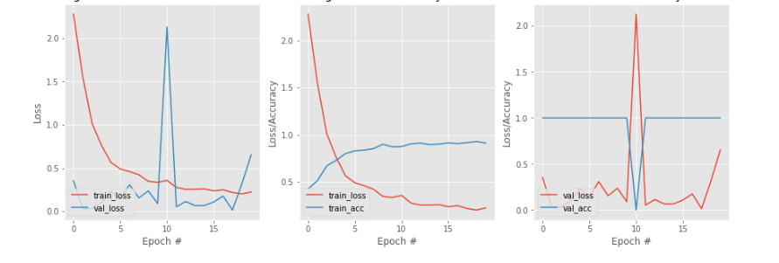
RESULT
Training Loss and Validatation Loss
Dataset Training Loss and Accuray
Dataset Validation Loss and Accuracy

Slide 12
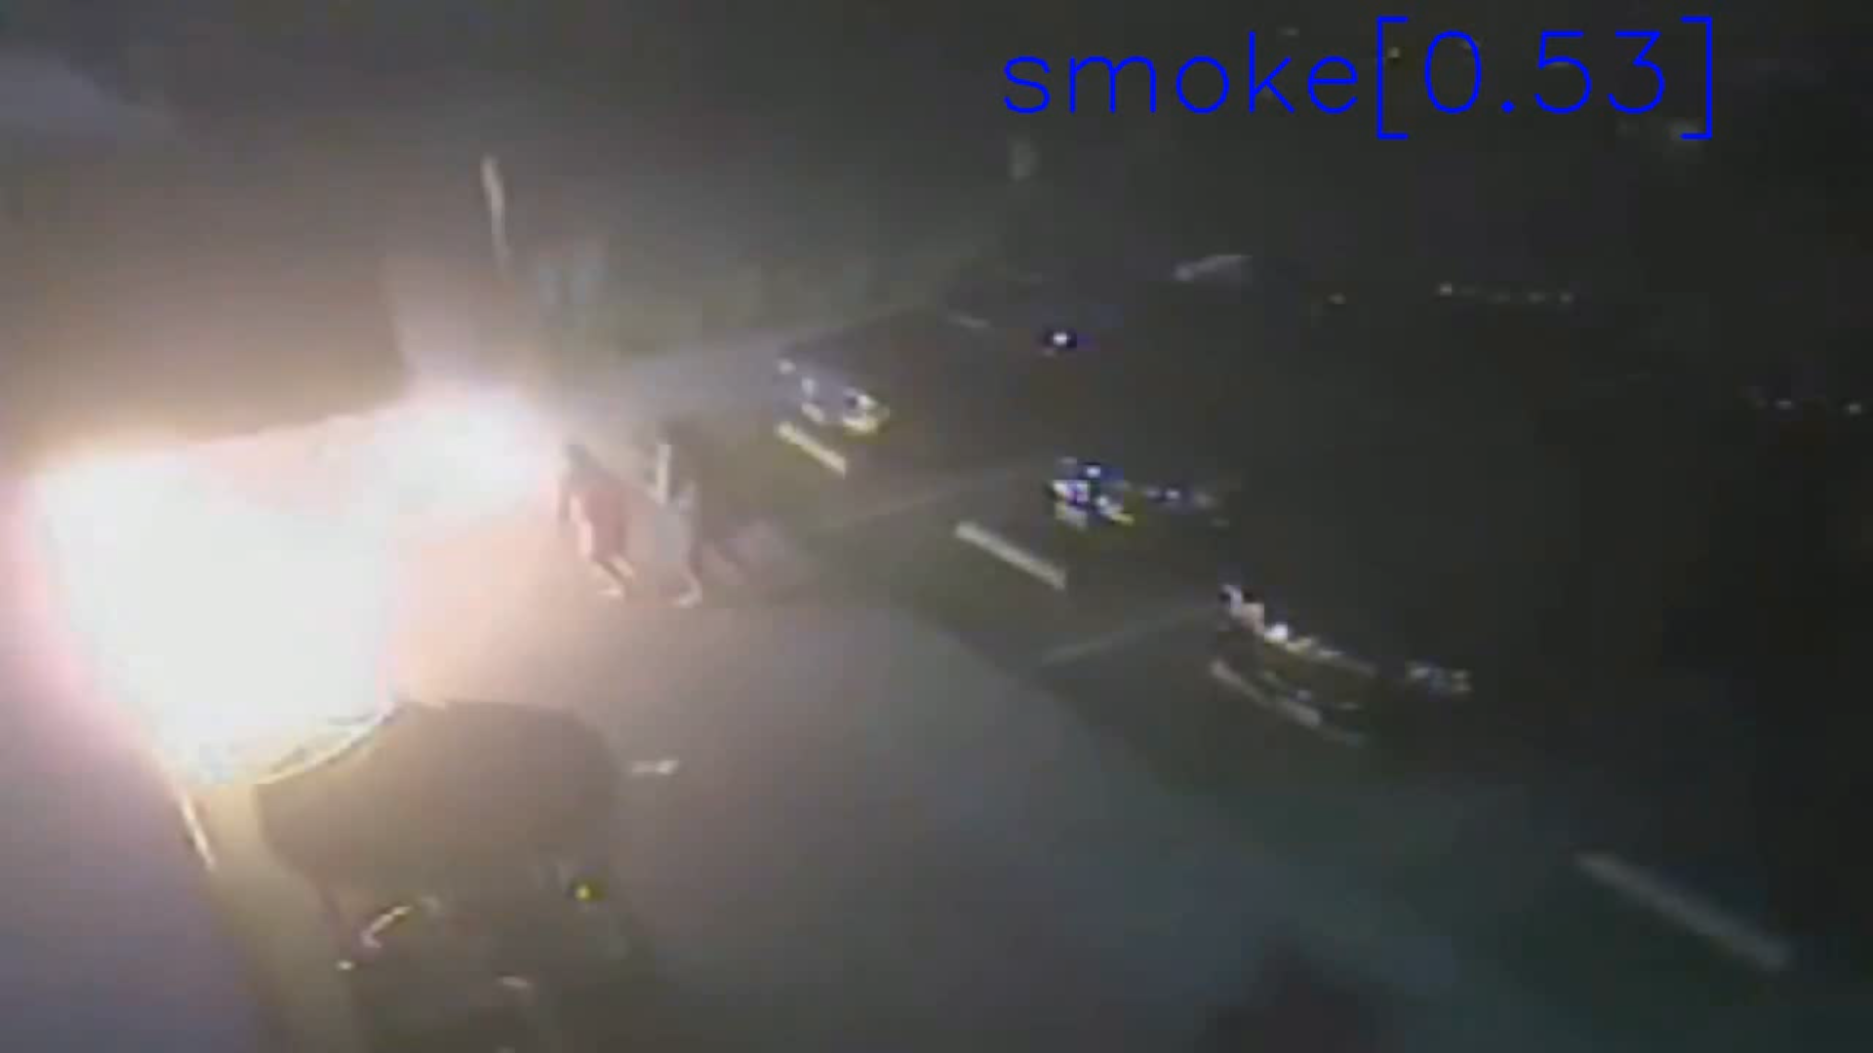
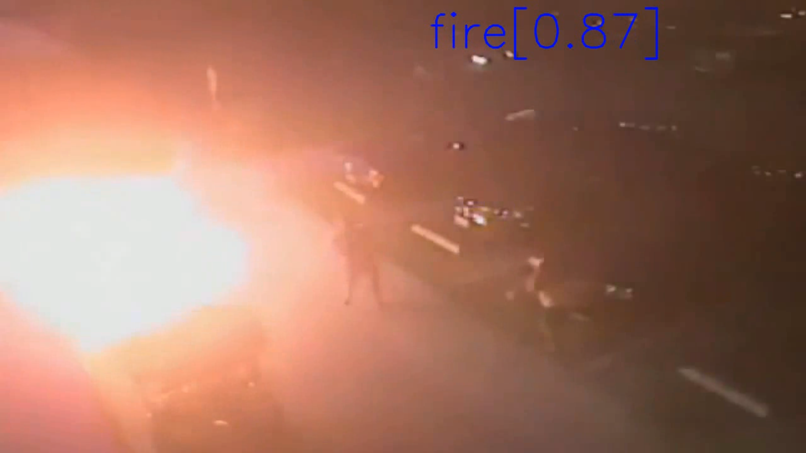
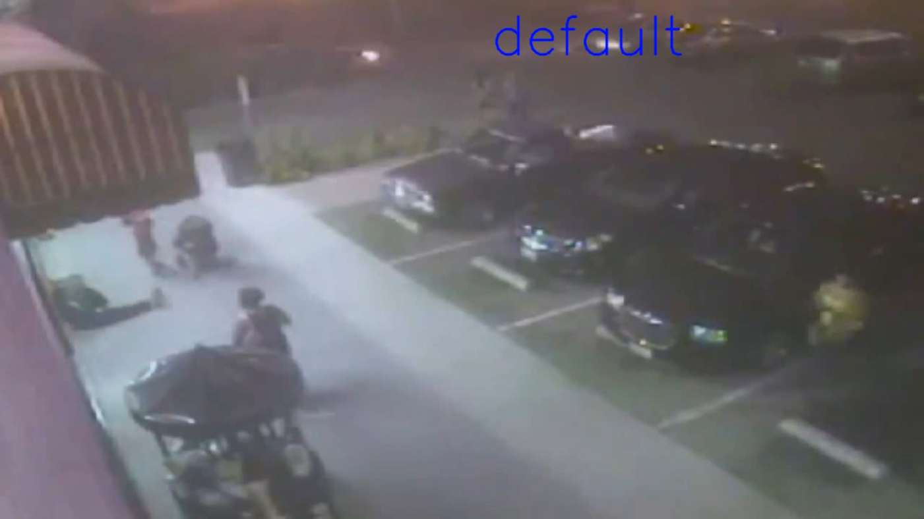

Slide 13
CONCLUSION
The development of a fire and smoke detection system in CCTV footage represents a significant advancement in safety and security measures. By leveraging cutting-edge technology and innovative approaches, we have created a reliable solution to mitigate fire-related risks effectively.
As we continue to refine and optimize the system, we remain committed to ensuring the most safety and well-being of our communities.

Slide 14
REFERENCES
https://www.pyimagesearch.com/2018/12/24/how-to-use-keras-fit-and-fit_generator-a-hands-on-tutorial/
https://medium.com/@vijayabhaskar96/tutorial-image-classification-with-keras-flow-from-directory-and-generators-95f75ebe5720
https://www.learnopencv.com/read-write-and-display-a-video-using-opencv-cpp-python/
https://github.com/bikz05/ipython-notebooks/blob/master/computer-vision/displaying-video-in-ipython-notebook.ipynb

